Slide 1
Some steps for fantastic Portfolio Website
Writing Effective & Convincing Copy

Slide 2
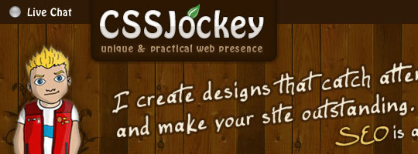
Logo
Your logo is usually the first thing a user sees. In the Western world, we read from left to right, top to bottom, so it makes sense to put your logo in the top left of your website so that users can immediately identify who owns the website.

Slide 3
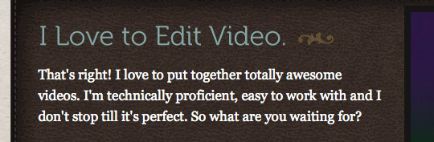
Tagline
Once the user sees who owns the website, they’ll want to know what it is you do. This is where you explain what you do with a tagline.
Your tagline should be short and snappy, summarizing what you do.

Slide 4

Portfolio
This is a personal portfolio website after all, so your portfolio will determine whether the website is interesting or not.
Depending on what you do, your portfolio should contain big high-quality images, clearly accessible to the user.

Slide 5

Services
Your tagline summed up what you do, but you’ll want to go into a bit more detail here about each service that you offer.
Make it clear, and break it down: Web design, development, video, copywriting, branding, etc.

Slide 6
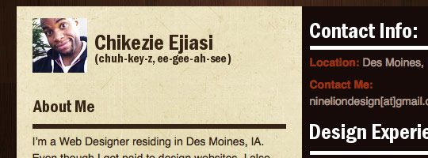
About me
It’s all about you. Let people see the man or woman behind the mask (i.e. website). Share your background, where you came from, how many years you’ve been in the business, etc.
The more details you give, the better your users can form a bond and build trust with you.

Slide 7
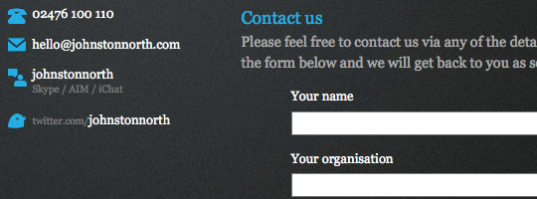
Contact
This is one of the most important elements of a portfolio website but is often hidden or even neglected.
A potential user has browsed your website, is impressed with your portfolio and can see who you are. Now they want to contact you.

Slide 8
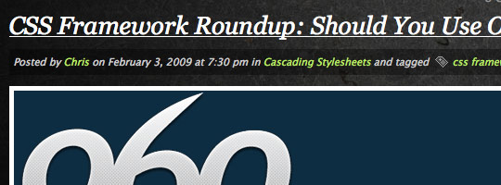
Blog
A blog is always a good idea. Blog about your area of expertise; show you know what you’re talking about. It will help promote you and prevent your website from lying static.

Slide 9
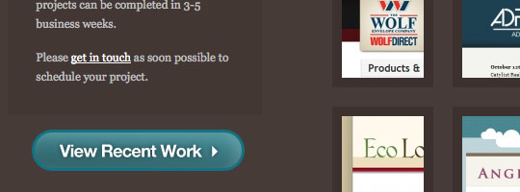
Call to action
Ask yourself what you want to get out of your personal portfolio website. Do you want to be hired? Attract more blog readers? Maybe you just want people to know who you are.
Each page should have a call to action, a “Next step.”

Slide 10
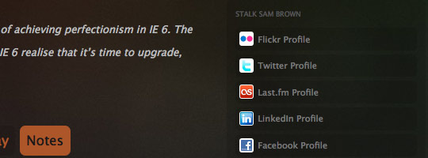
Use Social Networking websites
Now that people have an interest in you and your work, encourage them to follow you on other websites.
Make it clear that they can follow you on Twitter, Facebook, Flickr, LinkedIn, etc. Make the most of social networks and have a group of friends to call on if needed.

Slide 11
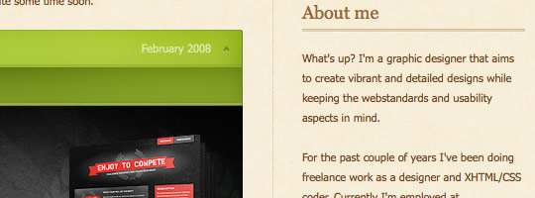
Language & Communication
Now that people have an interest in you and your work, encourage them to follow you on other websites.
Make it clear that they can follow you on Twitter, Facebook, Flickr, LinkedIn, etc. Make the most of social networks and have a group of friends to call on if needed.

